Slide 1
ReportPro End Project Review
Tom Atkinson – C2264402

Slide 2
Agenda
1
Company Info
2
Was it a success?
3
Development Process
4
Project Demo
5
Future Development

Slide 3



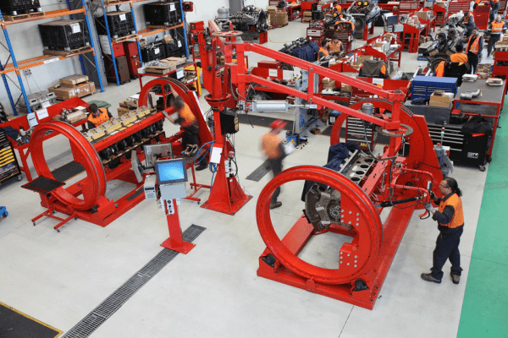

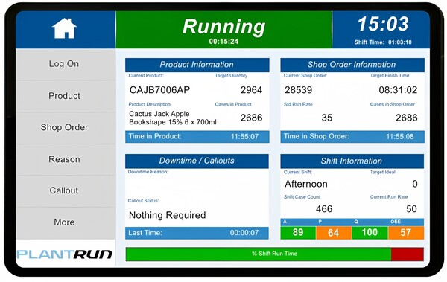


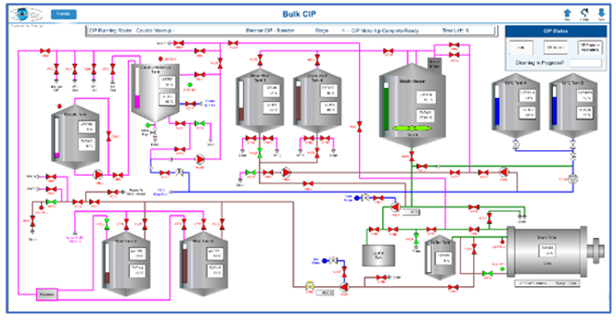
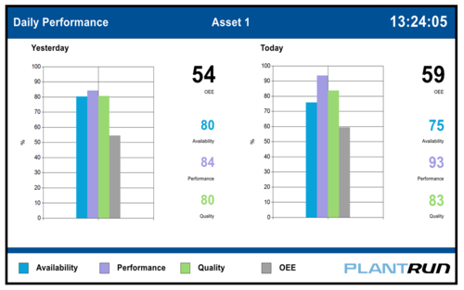
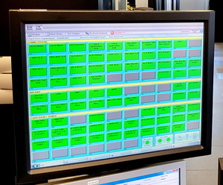

Prodigy specialises in engineering test automation and data acquisition systems.
PlantRun offers integrated hardware and software solutions designed to enhance operational efficiency for manufacturers by enabling real-time monitoring of production activities.
PAMS provides centralised alarm management specifically tailored for airfield ground-based systems.
Tascomp is a small UK technology company that mainly develop systems based on data collection and analysation for a large variety of customers. They offer three main products for customers: Prodigy, PlantRun and PAMS.

Slide 4
What is ReportPro?
M
Purpose
ReportPro was initially intended as a first look for Tascomp into machine learning for the purpose of data analysis and reporting. Currently PlantRun gathers a huge amount of useful data however the reporting output side and data analysis does not match that level.
Development
The project was initially planned and developed using R. However, over the course of the project it was debated over if Python would be a better choice to switch to. It is very likely that a switch to Python does take place when an appropriate point to do so is reached.

Slide 5
Was it a success?
Program
Initial Aim | Result
Use machine learning data analysis. | Random forest within R has been used with machine learning
Create new style of managerial reports using existing databases. | New style of reports are being included.
Be able to custom configure what is included throughout the various reports. | When created a location and expected completion time are required.
At the time of writing the program has not yet been fully completed. This is largely due to unforeseen other work taking priority. The program does still perform the base idea of performing analysis on data and using machine learning. I would say overall that ReportPro is on track to be a successful project despite the setbacks.
Costs
In terms of costs

Slide 6



Legal & Ethical
ReportPro will interact with user information. This data is subject to both legal and ethical requirements. The data should be protected and should not be available to anybody outside the target audience.
Hardware
The
Software
Constraints
There
Notes:
The Excel documents can often be forgotten about and it results in incomplete and non recorded training. This happens because the current process involves the trainer updating each trainees record through an excel spreadsheet.

Slide 7



Quality Assurance and Testing
Purpose of Testing
Development Phase
Trial Period
There was various testing stages to ensure its reliability and functionality. Testing is crucial for ReportPro as errors could lead to incorrect values, resulting in an unprofessional appearance, wasted time, and potential for incorrect decisions. The aim of the tests was to find and then fix any bugs or issues within the program.
Regular, thorough testing took place throughout development. Comments, try-catches, and other code features will be used to help reduce errors. Additionally, a detailed test procedure will be completed before release to test that all of the major features of the application work as expected.
Once I am confident that the program is functional, I will initiate a trial period. During this period, stakeholders will have the opportunity to test the program under realistic conditions, including stress tests. These tests will help identify any potential performance bottlenecks or shortcomings that need to be addressed before the program is deployed.

Slide 8
Time for a demonstration
ReportPro

Slide 9
What has been achieved?
1
L
What could I still learn?
2
3
1
A
1
H
4
2
2
3
3
5
4
6
4
What I have learned?
5
5
6

Slide 10
Possible Future Development
Create a new data source to better fit the requirements
Switch
to using
Python
A larger variety
of report types and configuration options
Custom dashboard
Simplify and split out code sections

Slide 11






Summary
General information about Tascomp
Reviewed the project timeline
Judged the success of the initial aims
Looked at the decisions and choices made
There was a demonstration of the application
Looked at possible future development ideas

Slide 12



Any Questions

